Slide 1

Sporadic Server
Shihab Ud Doula

Slide 2

Sporadic task VS Sporadic Server

Slide 3
Purposes
Handling Sporadic Task Arrivals
Timing Guarantees
Resource Management:
Flexibility and Adaptability
System Responsiveness:
Predictability and Determinism

Slide 4

TASK DESIGN OF SPORADIC SERVER
In Context of RTS mathematical formula of sporadic server;
Φs=(Ps,Es, θ, ρ)
PS represents the inter-arrival time.
ES represents the execution time.
θ represents the threshold time.
ρ represents the replenishment.

Slide 5

Replenishment
Refers to the process of restoring the server's resources or budget after it has served a task.
Process:
Internal Data Structures
Resetting Variables
Acquiring resources

Slide 6
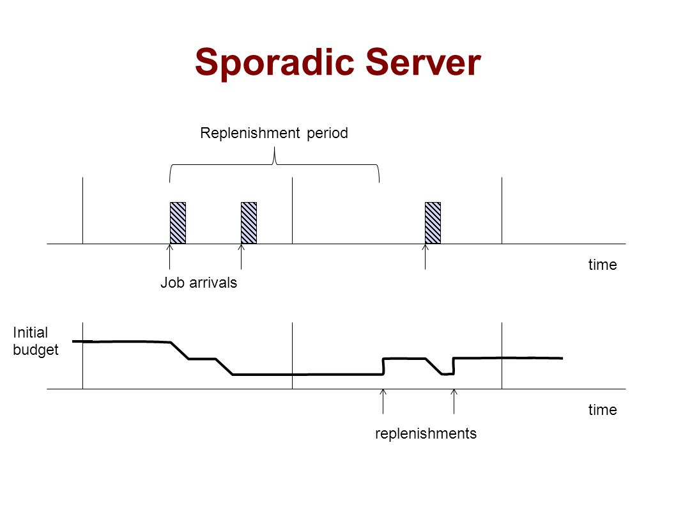
Sporadic Server Scheduling

Slide 7

Deferrable Server
Used As a conjunction of sporadic server
Flexibility with uncertain arrival times
Defer or postpone task with compromising performance

Slide 8
Future Implementation of DS
Advanced Deferral Policies:
Dynamic Deferral Time Calculations:
Adaptive Task Prioritization:
• Energy-Efficient Deferral Strategies:

Slide 9
About Code
In this code, the sporadic server simulation generates a specified number of sporadic tasks with random execution times, inter-arrival times, and deadlines. It then simulates the behavior of the sporadic server by executing the tasks based on their parameters and checking if they meet their deadlines. The simulation runs for a defined duration (simulationTime) and outputs the execution results for each task.

Slide 10
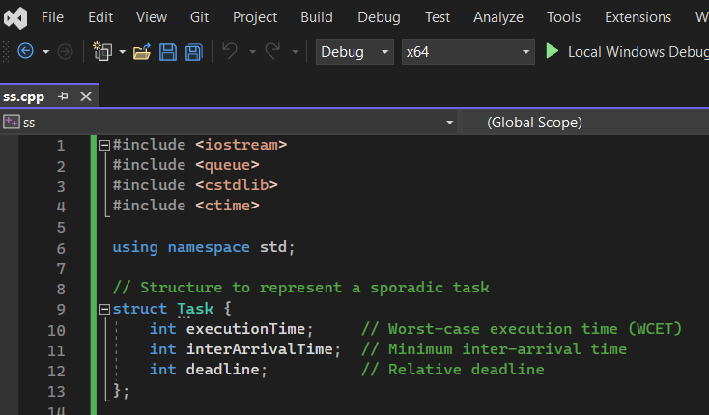
Implementation in C++

Slide 11
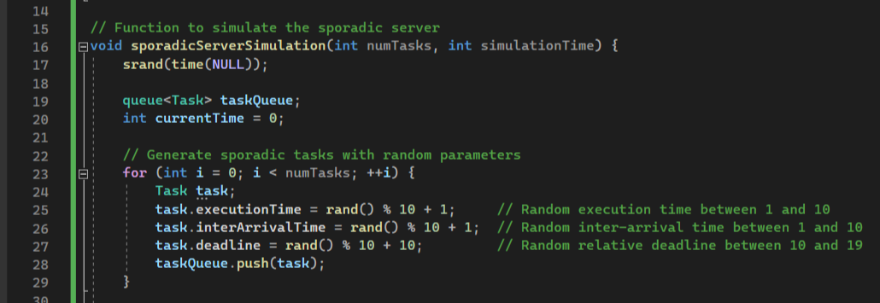

Slide 12
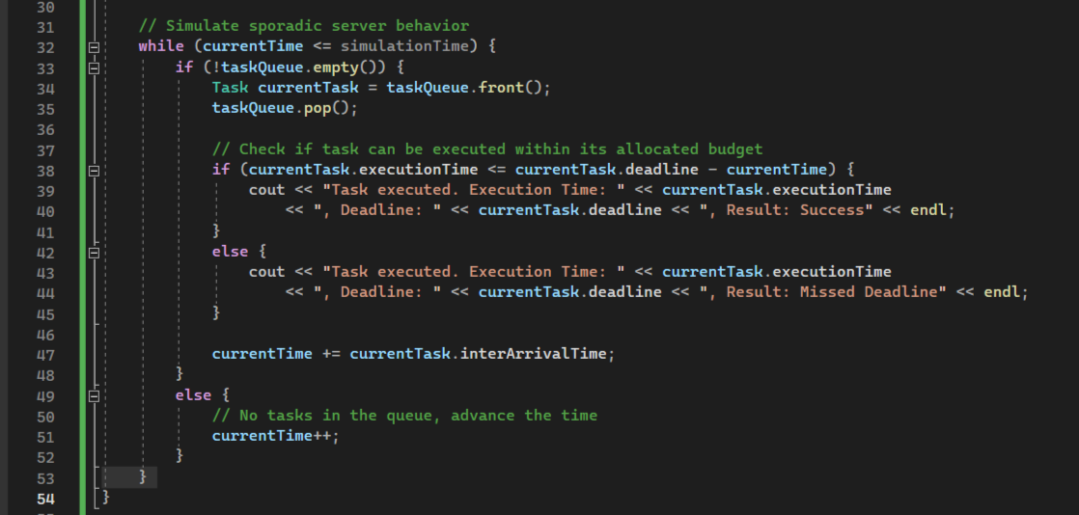

Slide 13
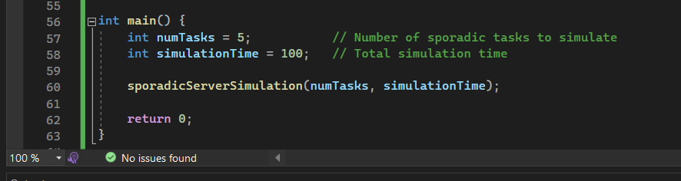

Slide 14
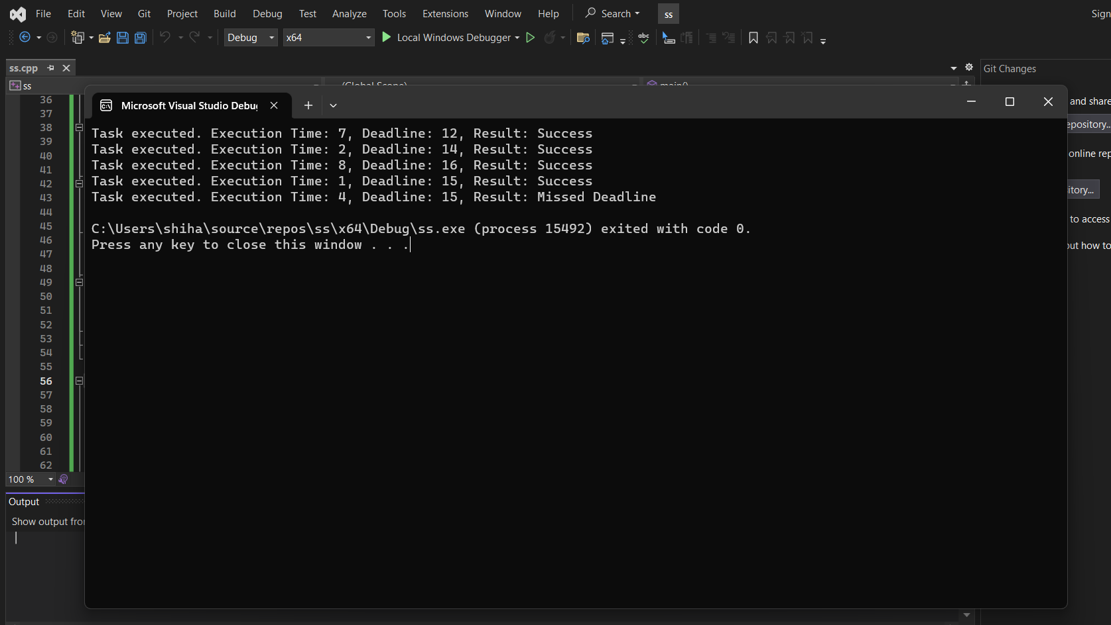

Slide 15
Thank You.
Questions?

